Slide 1
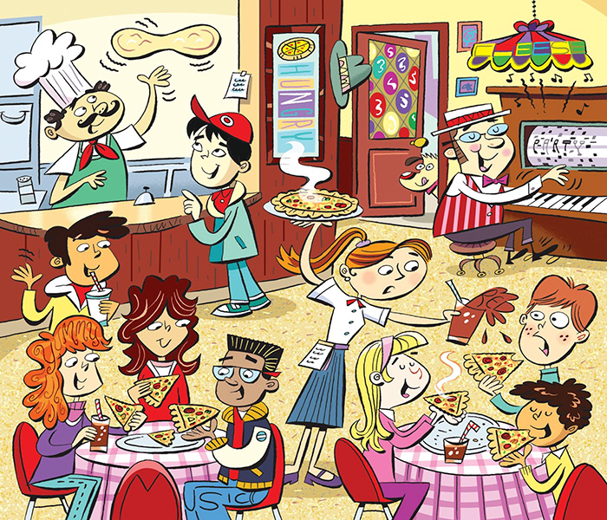
There are 6 hidden words. Where are they?

Slide 2
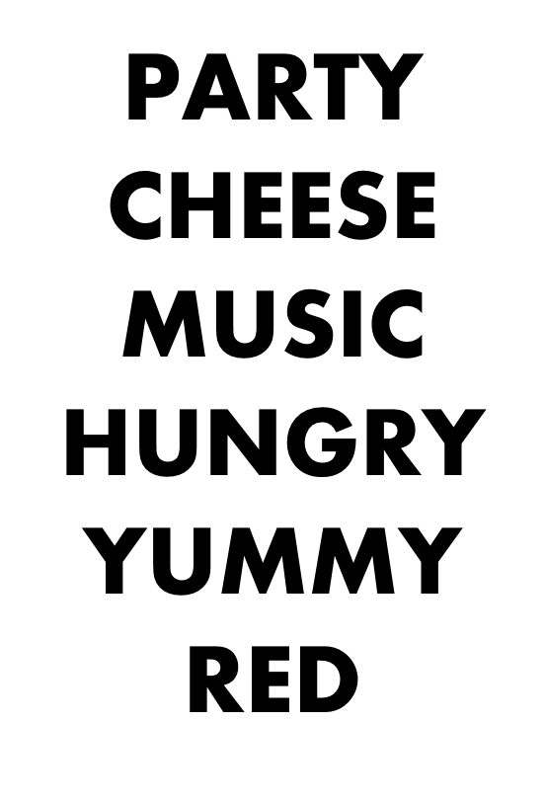

Slide 3
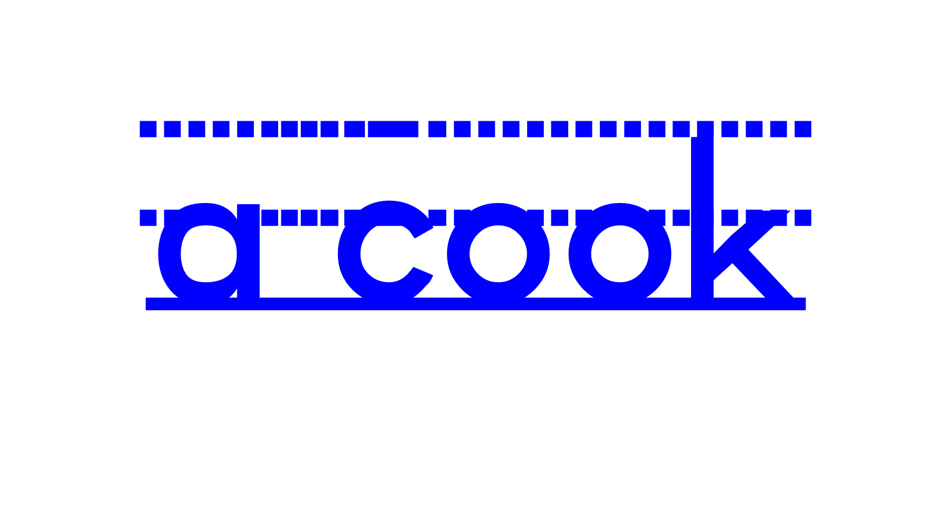
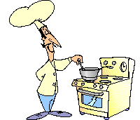
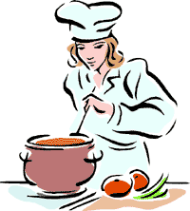

Slide 4
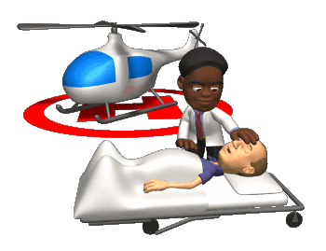
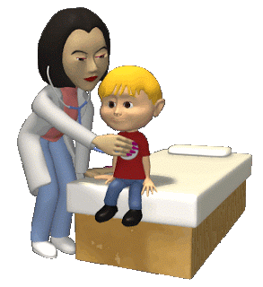

Slide 5
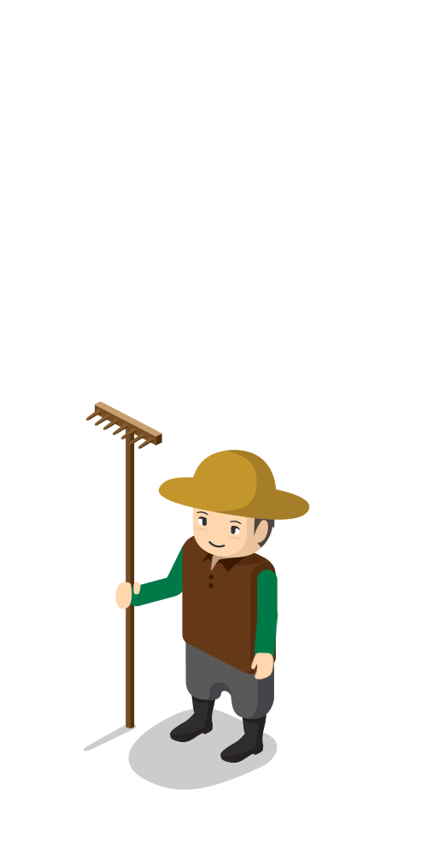
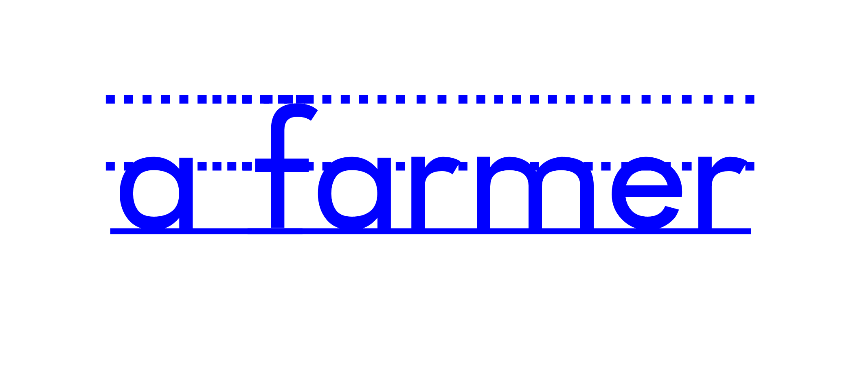

Slide 6
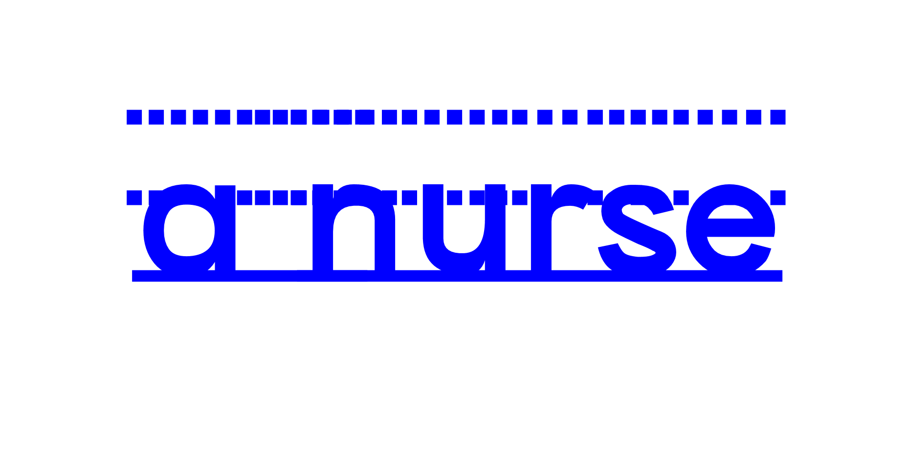
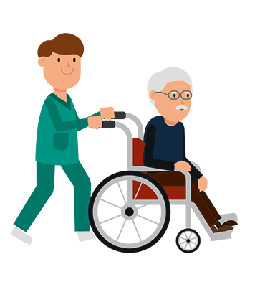
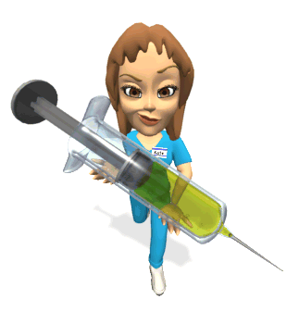

Slide 7
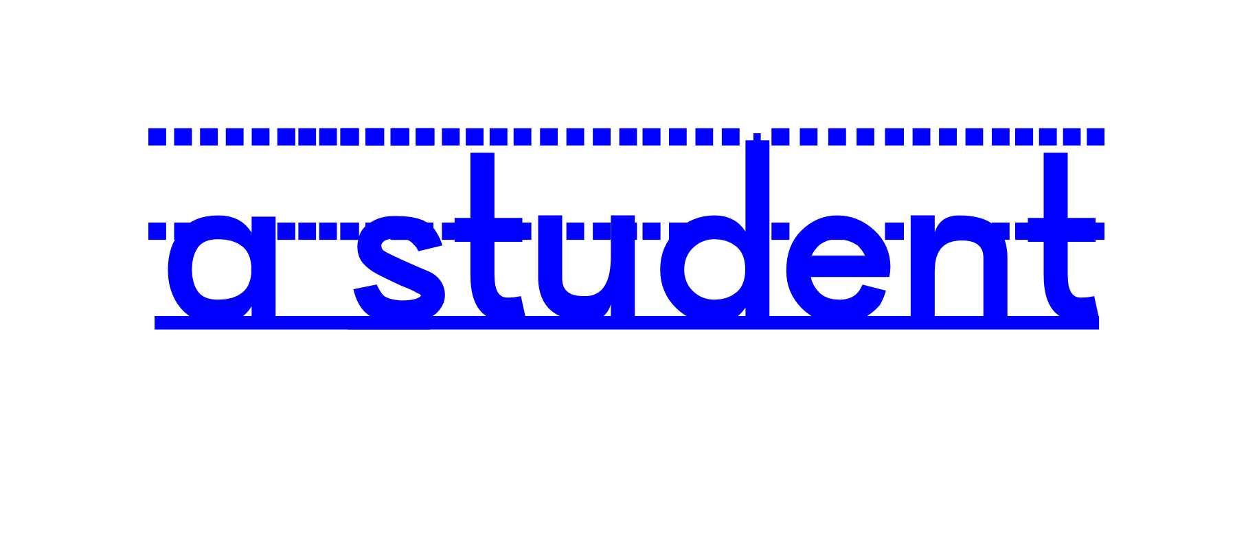

Slide 8
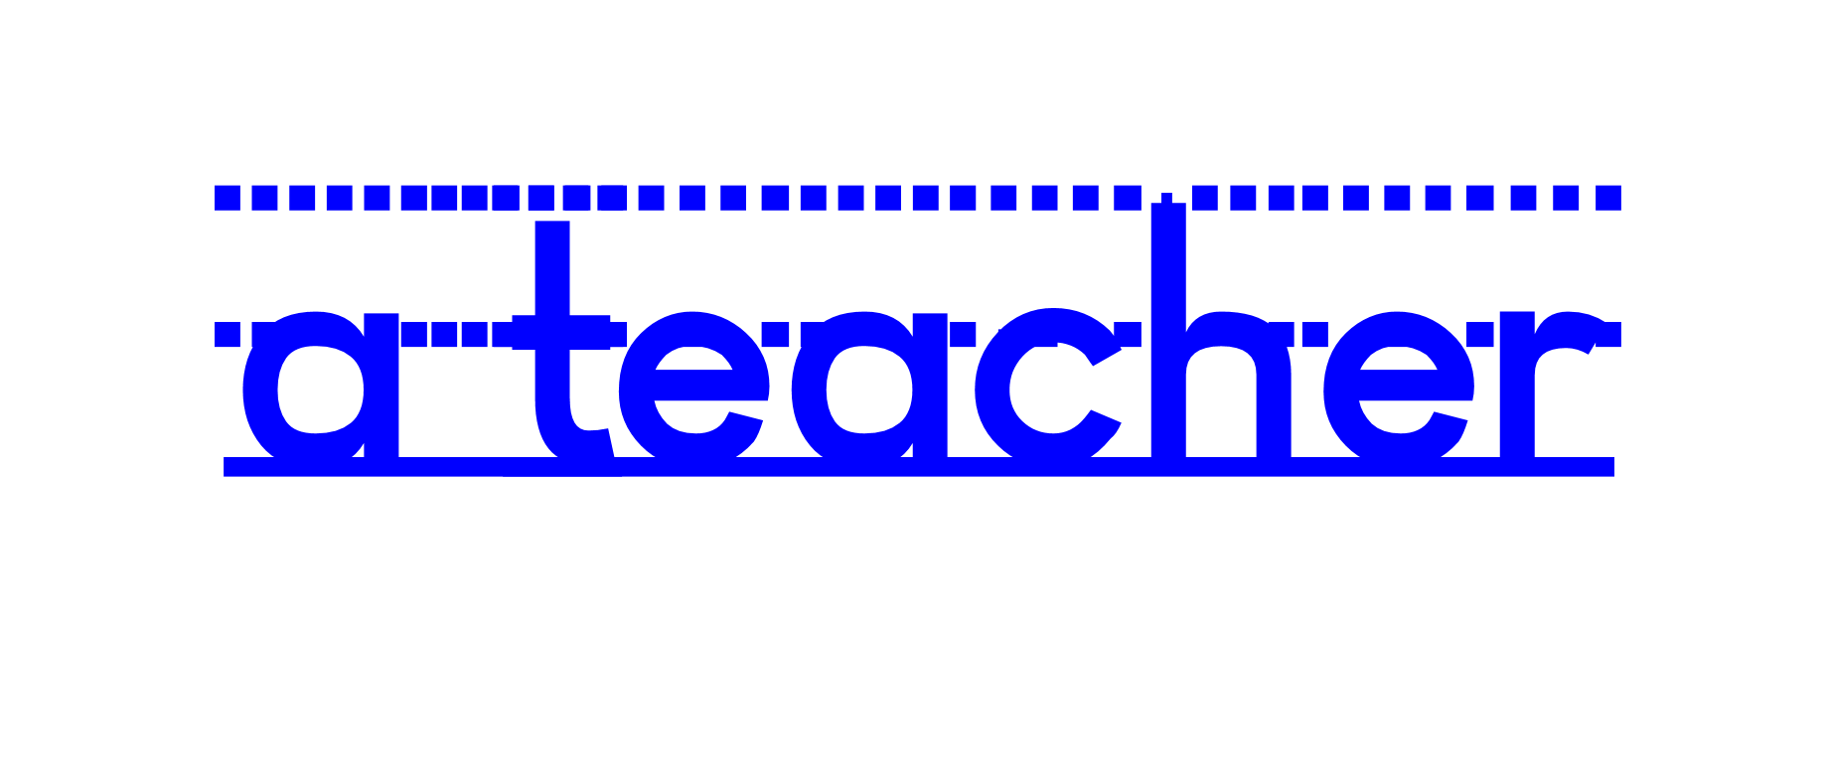
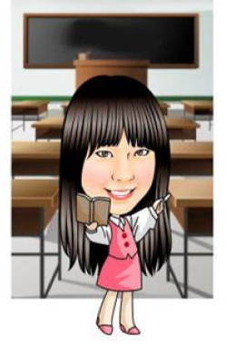

Slide 9
c
o
o
k

Slide 10
t
e
a
c
h
e
r

Slide 11
s
t
u
d
e
n
t

Slide 12
d
o
c
t
o
r

Slide 13
n
u
r
s
e

Slide 14
f
a
r
m
e
r

Slide 15
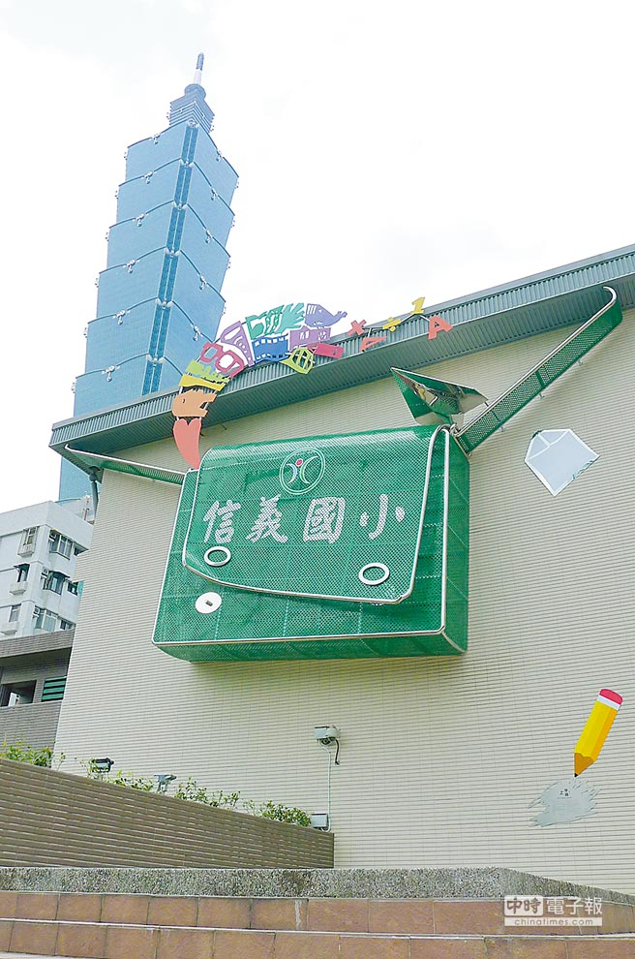
Are you a student?
Yes, I am.

Slide 16
Are you a cook?
No, I’m not.

Slide 17
Is he a teacher?
Yes, he is.

Slide 18
Is she a doctor?
No, she isn’t.

Slide 19
名人Q&A

Slide 20
Is she a student?
Yes, she is.

Slide 21
Is he a cook?
No, he isn’t.
He’s a doctor/ mayor.

Slide 22
Is she a nurse?
No, she isn’t.
She’s a singer/ dancer.

Slide 23
Is he a teacher?
No, he isn’t.
He’s a president of the USA.

Slide 24
Is he a student?
Yes, he is.
No, he isn’t.
He’s a detective.

Slide 25
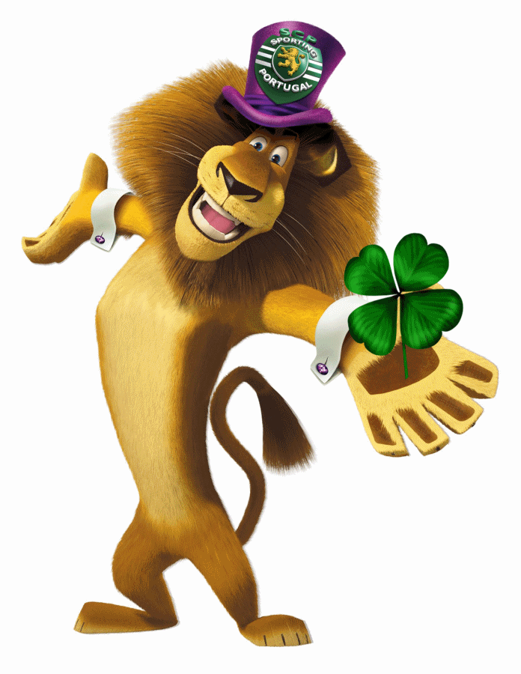
名人Q&A part 2

Slide 26
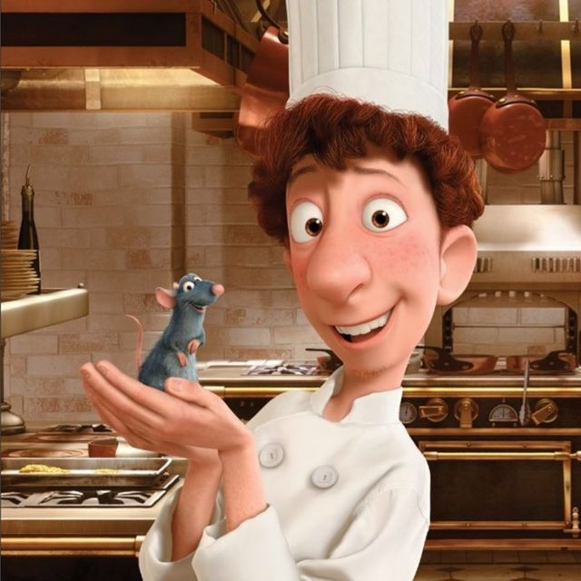
Is it a cook?
Yes, it is.

Slide 27
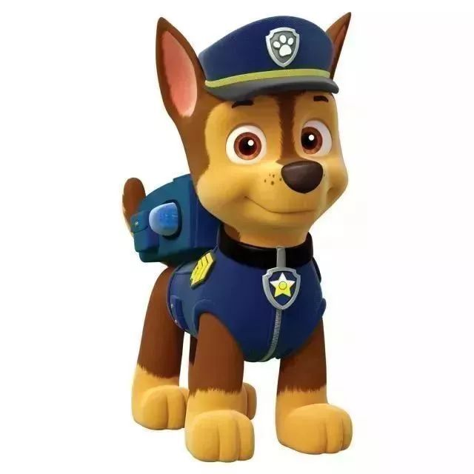
Is it a student?
No, it isn’t.
It’s a patrol.

Slide 28
Is he a doctor?
No, he isn’t.
He’s a businessman/
superhero .

Slide 29
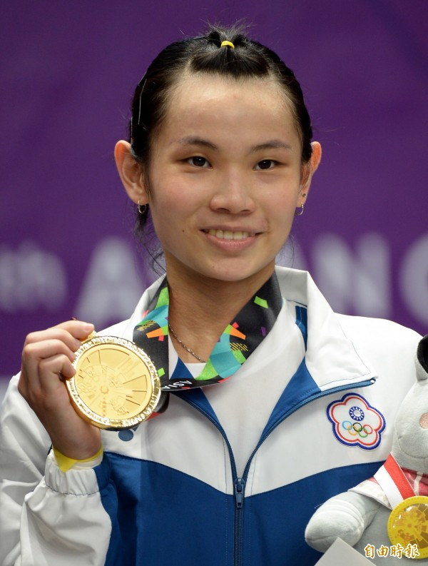
Is she a farmer?
No, she isn’t.
She’s a badminton player.
戴資穎/ Tai Tzu Ying

Slide 30
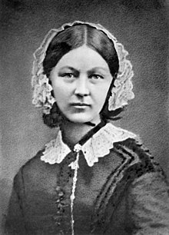
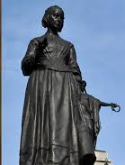
Is she a nurse?
Yes, she is.
佛蘿倫絲·南丁格爾/ Florence Nightingale

Slide 31
Is he a doctor?
No, he isn’t.
He’s a teacher.
孔子/ Confucius

Slide 32
Yes, I am.
Yes, he is.
Yes, she is.
No, I’m not.
No, he isn’t.
(he’s not)
No, she isn’t.
(she’s not)
Yes簡答不可以縮寫

Slide 33
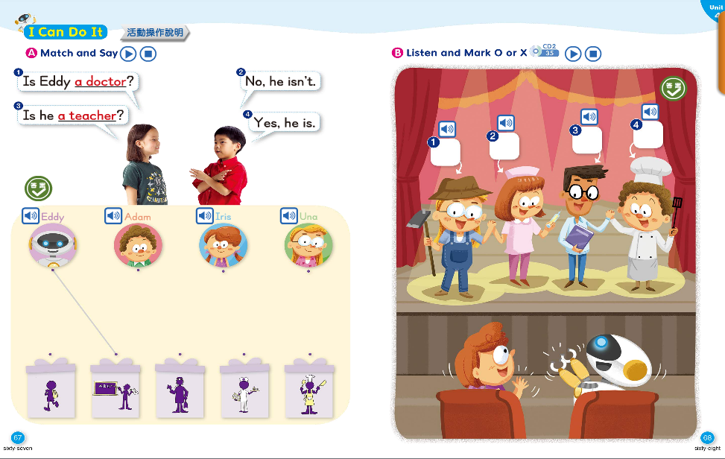

Slide 34
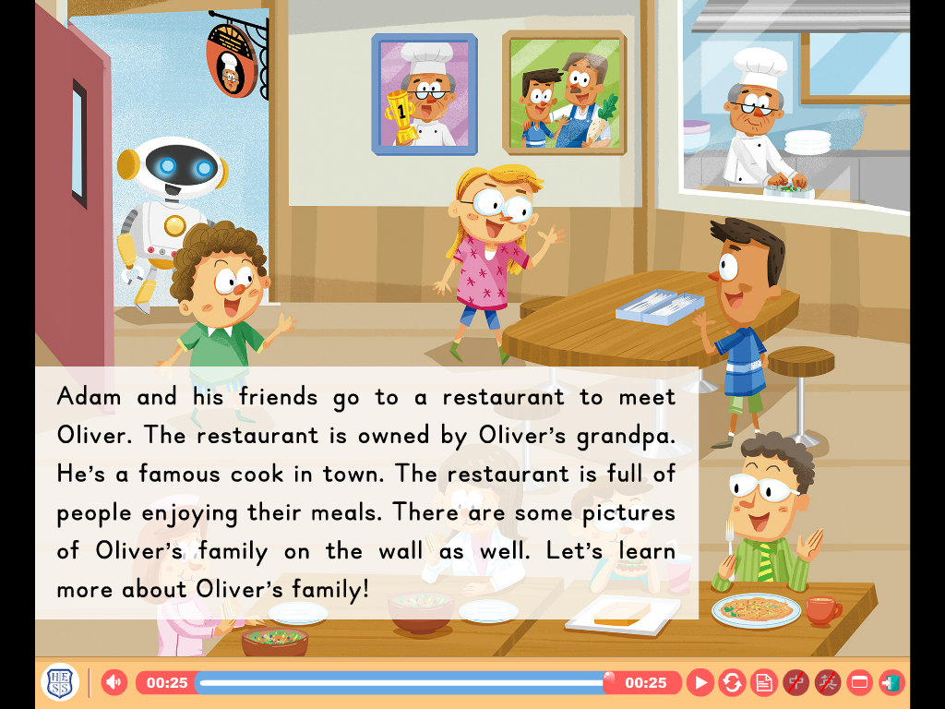

Slide 35
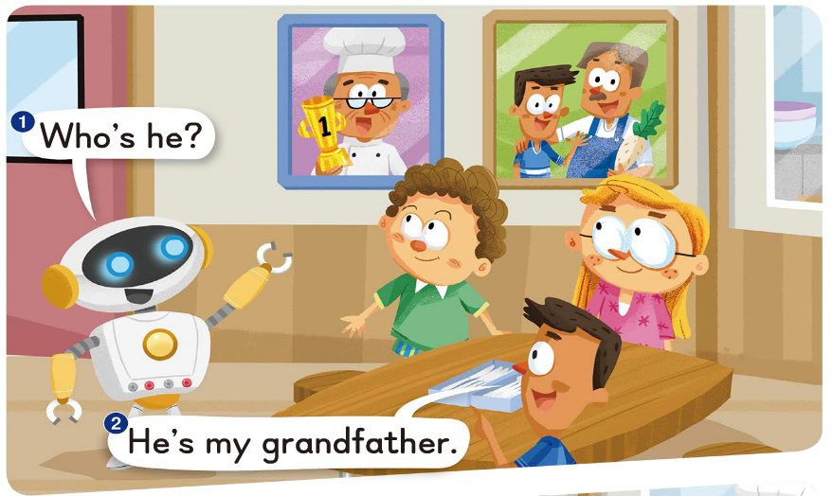

Slide 36
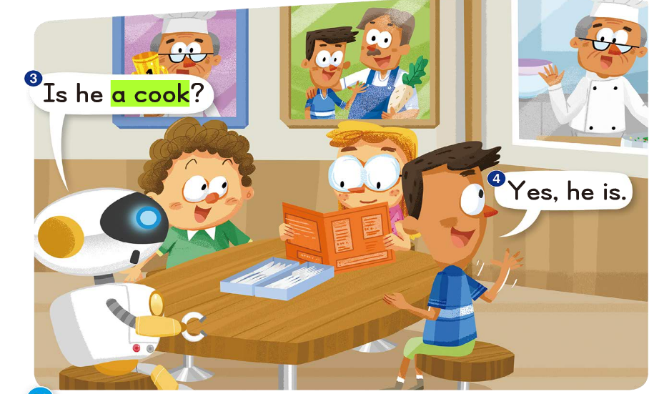

Slide 37
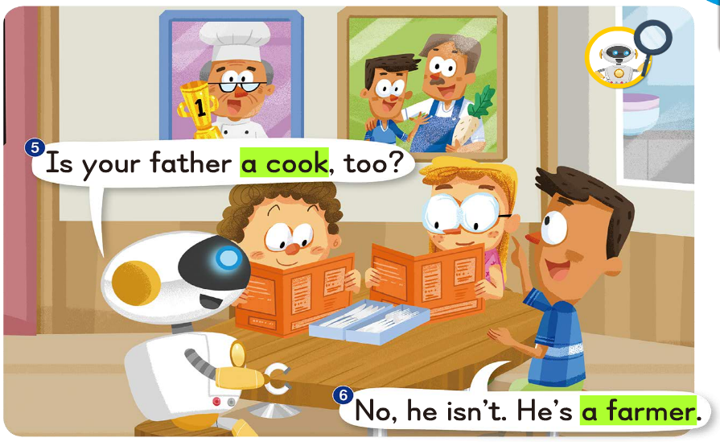

Slide 38
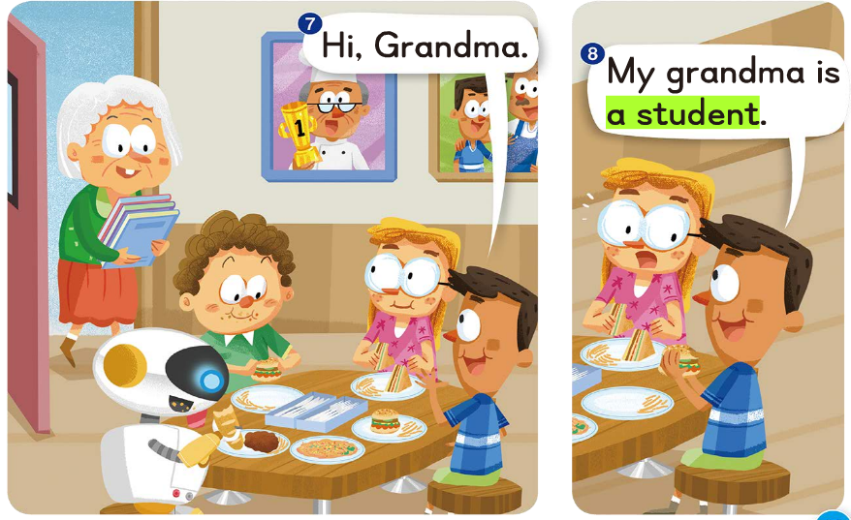

Slide 39
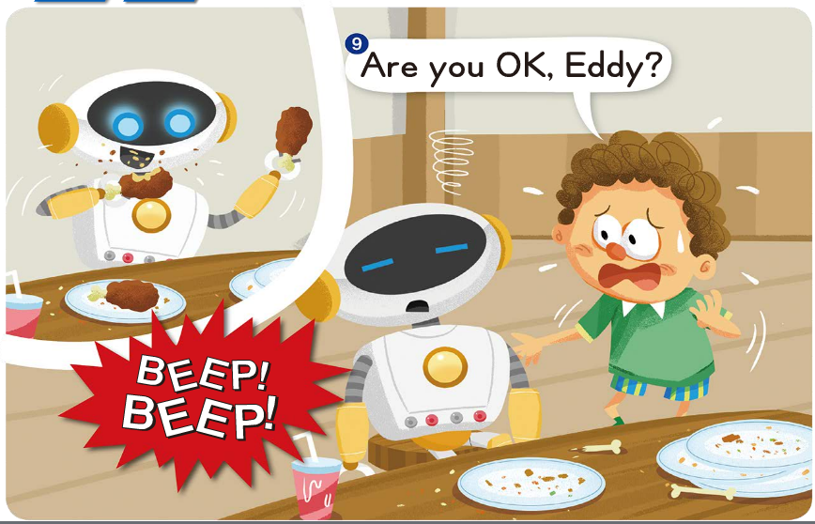

Slide 40
